Slide 1

Analyzing a logistic processes of a mobile firm & improvement suggestions.

Slide 2

Abstract
This report gives an exclusive insights into the analysis of a logistics process of a mobile firm, analyzing the different aspects that must be understood before lunching the brand into the worldwide market.

Slide 3
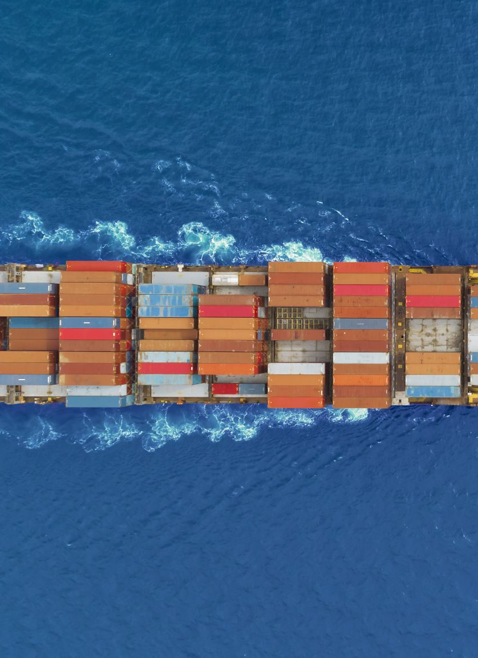
Logistic Analyzation.
Manufacturing Location: we need to search the most profitable manufacturing location
Manufacturing Resources: there are a variety of sorts of product, some requires a huge amount of resources that can only be found in some countries.

Slide 4
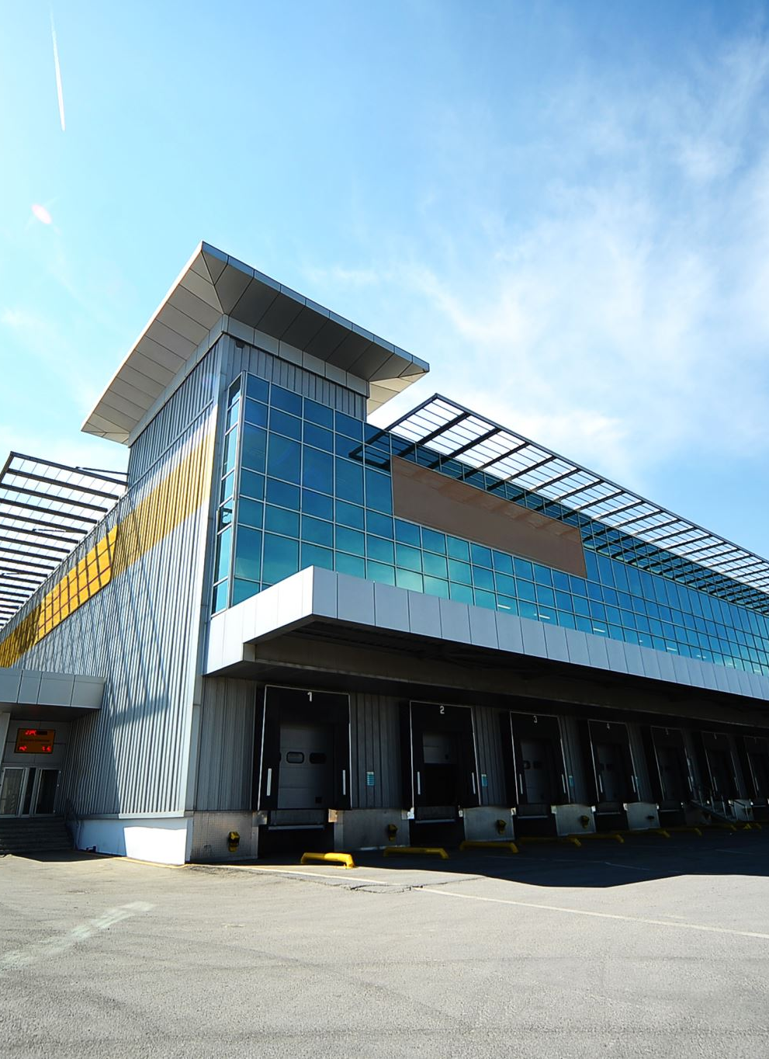
Definition of the firm
the firm want to compete in the mobile phone market, but they failed to do so, due to lack of strategic fit and bad supply chain management the manufacture, suppliers, and distributors are locally operated. Thus, high cost for the customers outside of turkey.

Slide 5

Business unit
Strategic context: our firm is currently devolving due to not improving their systems, with bad logistics which make the business costly and unhealthy.
Competitive advantage: we need to set a unique position, capabilities that allow us to create user value by delivering an offer that exceeds that of competitors or reducing its cost by delivering the same offering as competitors but at a lower cost (or both).

Slide 6
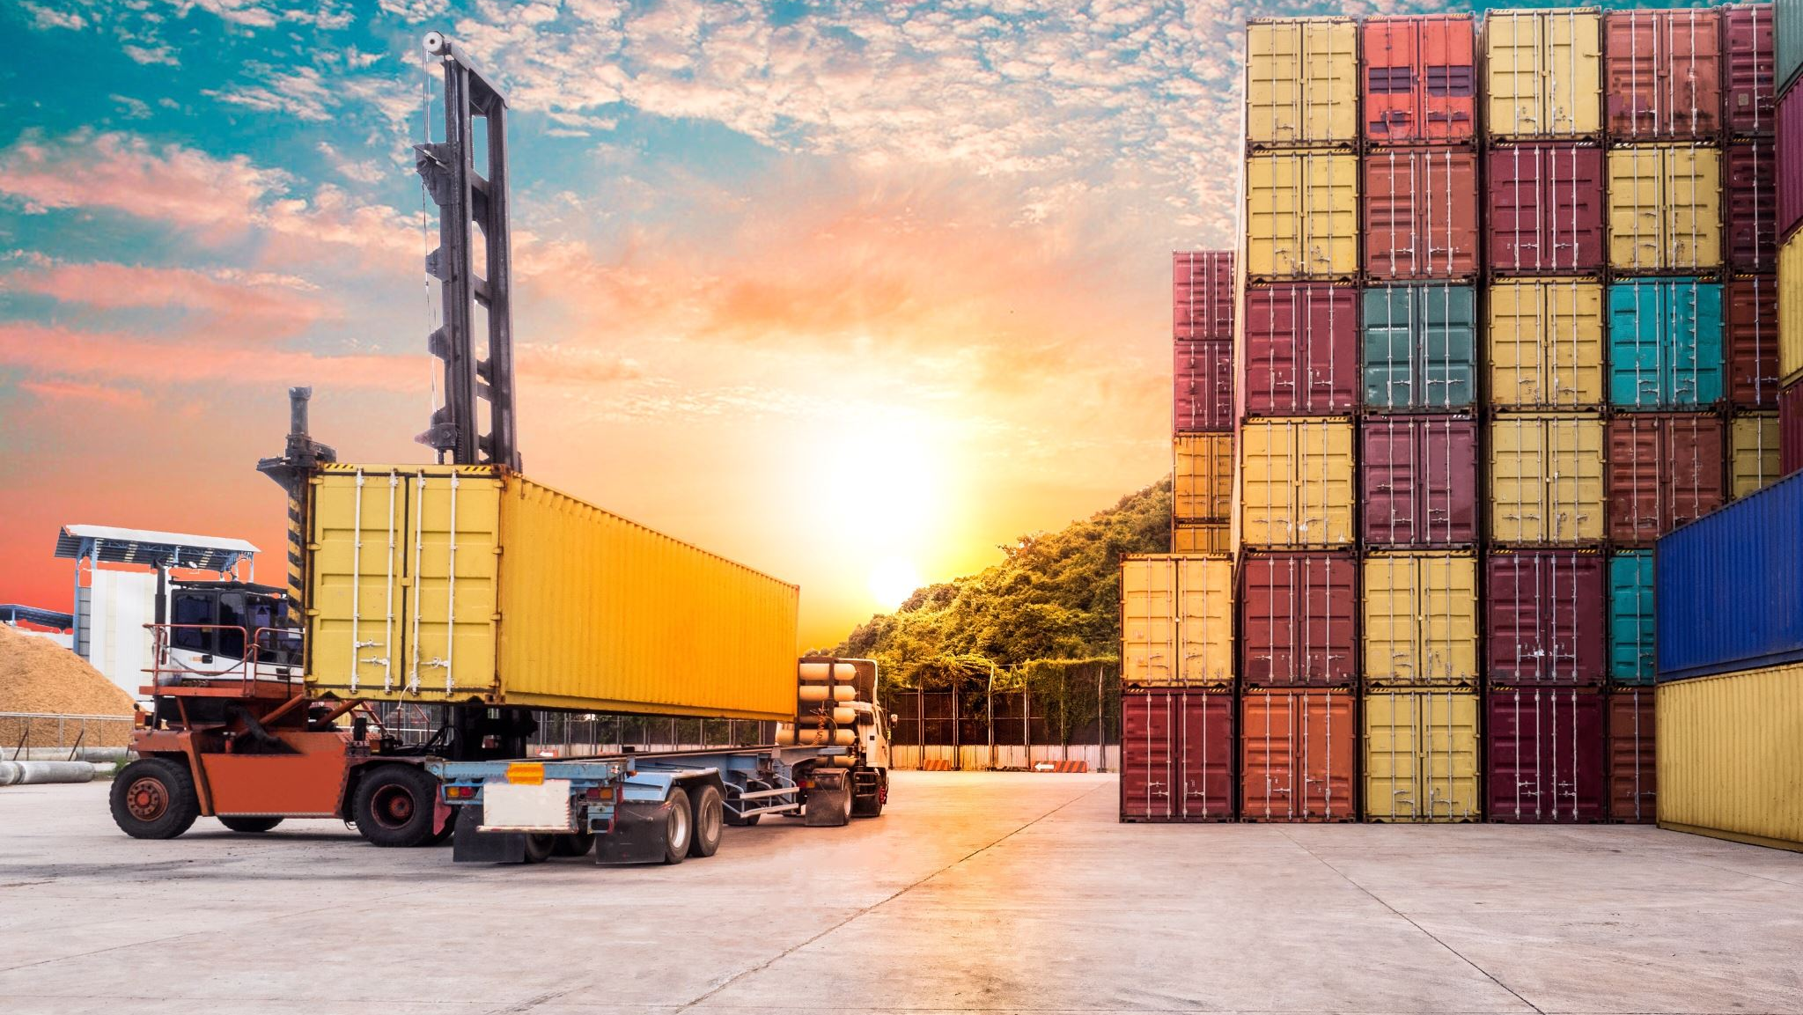
Our logistics goals
Rapid response capability to the changes in the market or customer orders.
Minimize variances in logistics service.
Minimize inventory.
Consolidate product movement by grouping shipments.
Maintain high quality and engage in continuous improvement.
Support the entire product life cycle and the reverse logistics supply chain.

Slide 7

Our logistics tactics
Coordination functions: we need to locate our manufacture in a country with a labor cost less than turkey to minimize the labor and transportation cost.
Reducing number of partners: the more partners there are in chain the more difficult and expensive the chain is to manage.
Integrating the supply chain.

Slide 8

current process structure
the current competitive strategy is to be a competitive mobile phone locally. The current SC structure is somewhat responsive.
Drivers of the structure:
Information: a lot of the time when we process our information it might affect our decisions and create a lot of cost savings or performance improvement.
Inventory: due to lack of inventories our inventory cost is increasing but our facility cost is good.
Transportation: since our facilities are all local the transportation is so efficient and not costly.
Location: the location is not good for a company who want to be a global organization since no warehouses or facilities near most of the world.

Slide 9
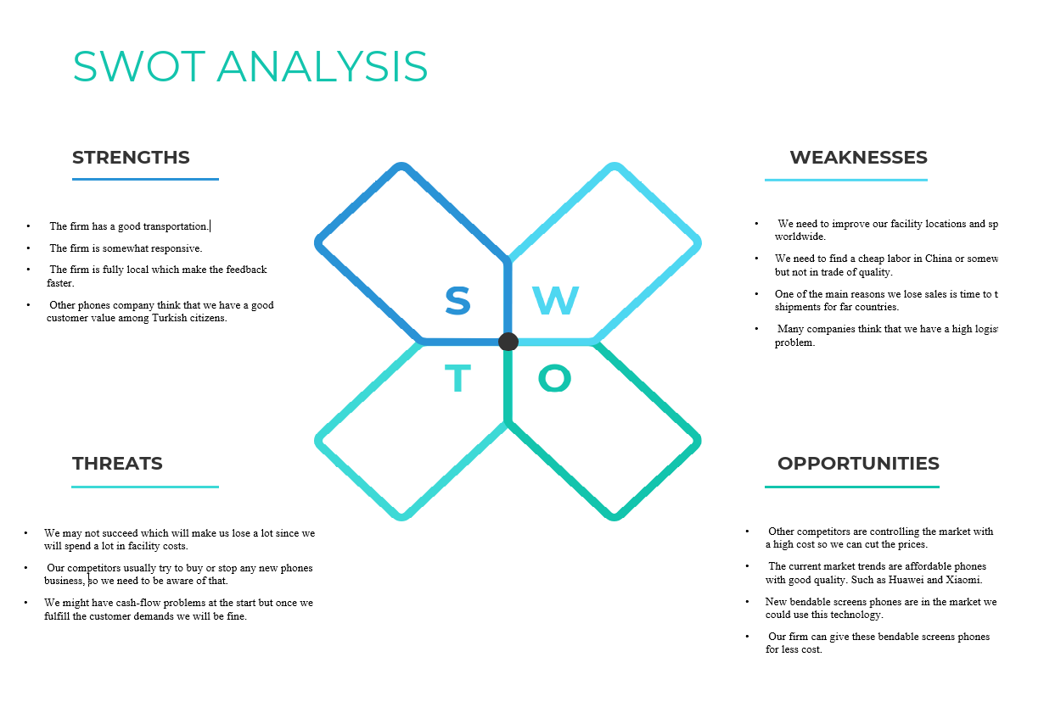

Slide 10

New process structure
In addition to our previous logistics tactics, we need to change the competitive strategy.
It was easier to collect feedback because we were working in a small supply chain but now since we are going global, we need to value information more.
In inventory, we need to increase it and distributed around the world perfectly.
considering that facility cost will increase rabidly so cash flow should be managed.
The location of the facilities should be picked depending on the cost and the quality of the product.
we will ship most of our products from the ocean since China is in the specific ocean which will make the transportation cost lower, but this might affect the responsiveness.

Slide 11

Discussion
What is the timeline of all these changes?
we need to put a 4 years vision to change the current structure and distribute the facilities around the world.
How are we planning to afford all these changes?
we need to open the brand to public stocks so we can afford the cash flow and we need to use 3rd or 4th party to help us in the short term.

Slide 12

References
"TOYOTA: IMV Project". Toyota. Archived from the original on February 21, 2008.Retrieved February 29, 2008.
Koetse, M. (2019, May 30). Top 10 China’s Most Popular Smartphone Brands & Models
(May/June2019) This is original content by What is on Weibo that requires investment.
Wageindicator.org. (n.d.). Minimum Wage Check.WageIndicator Subsite Collection.RetrievedJune3,2020,fromhttps://paycheck.in/salary/minimumwages.
Costello, S. (2021, January 27). Where Is the iPhone Made? Lifewire. https://www.lifewire.com/where-is-the-iphone-made.
ELLEN, A. A. I. D. E. N. (2019). Global Strategic Business Management: Focusing on the Strategic Business Unit of Amazon Whole Foods. Journal of Research on the Lepidoptera, 51(1). https://doi.org/10.36872/lepi/v51i1/30100.
Schooley, S. (2019, June 23). SWOT Analysis: What It Is and When to Use It. Business News Daily. https://www.businessnewsdaily.com/4245-swot-analysis.html.

